Slide 1
Examining Geographic Disparities in Asthma Mortality Rates Across Counties in California
Anuradha Vyas
(EPBI 5003: Spatial Analysis in Public Health)

Slide 2

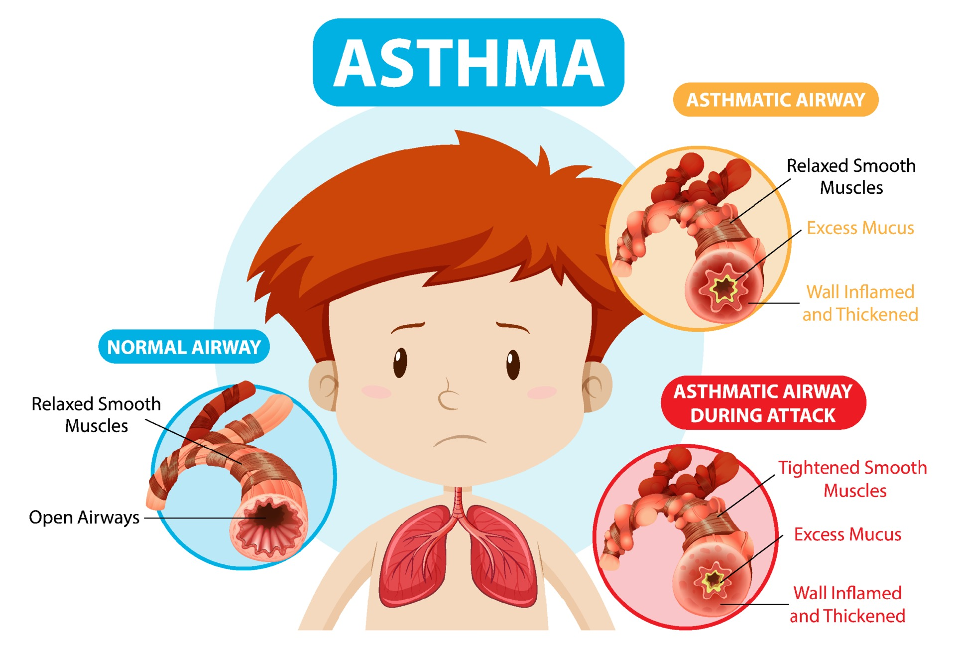

background
Asthma is a prevalent chronic respiratory condition that impacts individuals of all ages, leading to symptoms like wheezing and shortness of breath (CDC, 2020). While manageable with treatment, severe cases can result in hospitalization or death (GINA, 2021). In California, asthma ranks among the top causes of hospital visits, imposing significant burdens on individuals and healthcare systems (California Department of Public Health, 2019). To address this issue effectively, it's crucial to analyze asthma mortality rates at the county level to pinpoint areas with the greatest need for intervention and reduce disparities in healthcare access and outcomes (American Lung Association, 2020).

Slide 3
Goal
To examine Geographic Disparities in Asthma, Age-adjusted Mortality Rates Across Counties in California

Slide 4
Data
“The dataset contains counts and rates (per 1,000,000 residents) of asthma deaths among Californians statewide and by county. The data are stratified by age group (all ages, 0-17, 18+) and reported for 3-year periods. The data are derived from the California Death Statistical Master Files, which contain information collected from death certificates. All deaths with asthma coded as the underlying cause of death (ICD-10 CM J45 or J46) are included.
Source: https://www.cdph.ca.gov/Programs/CCDPHP/DEODC/EHIB/CPE/Pages/CaliforniaBreathing.aspx
Last updated at https://data.chhs.ca.gov : 2021-11-10
License: https://data.chhs.ca.gov/pages/terms”

Slide 5


spatial data processing method
Data
Shp file
Edited variables “NAMESLSAD”in Shp file to
add join Data to shp file
It contained “County”.
code
! NAMESLSAD!.replace("county", "")
Ensured data quality and compatibility through rigorous validation processes
Joining spatial data to link asthma Deaths with geographic locations (Join tables)

Slide 6
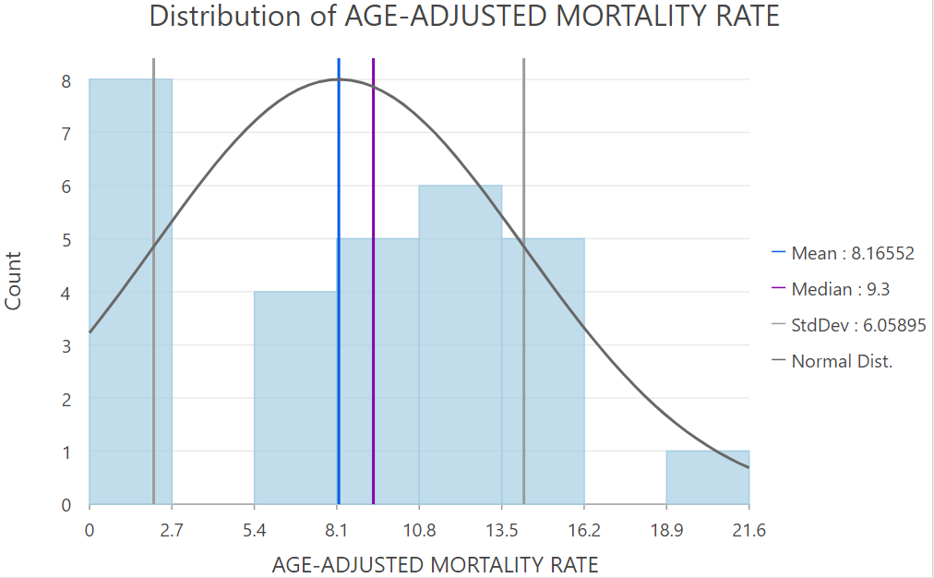
Descriptive statistics
Distribution of Age-adjusted Mortality Rates is also right skewed

Slide 7
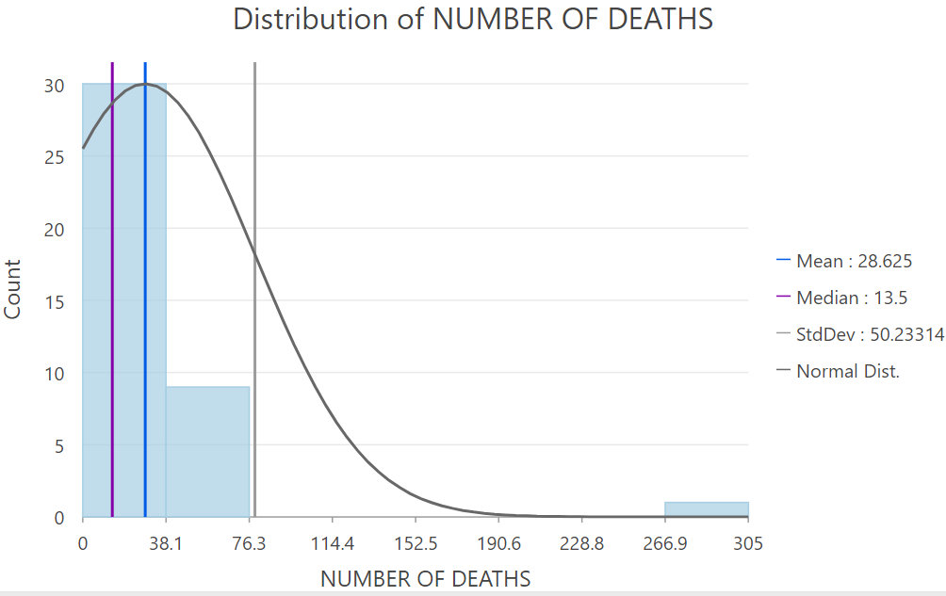
Descriptive statistics
Distribution of number of deaths is right skewed

Slide 8
Analysis: Hot spot (Getis-Ord Gi)
Getis-Ord Gi Statistic:
The Getis-Ord Gi statistic is used for identifying spatial clusters of high or low values within a geographic area.
GIS Software:
Utilized ArcGIS software
Calculate the Getis-Ord Gi Statistic:
This statistic calculates z-scores and p-values for each county, indicating whether it is a hot spot or a cold spot.

Slide 9
Method: Hot spot (Getis-Ord Gi)
load the joined dataset.
Navigate to the Spatial Statistics toolbox.
Choose the tool for calculating the Getis-Ord Gi statistic. In ArcGIS, this tool is usually found under the "Density" or "Hot Spot Analysis" category.
Configure the tool parameters:
Input feature class: California counties shapefile or feature class.
Input field: Select the field containing Age-adjusted Mortality Rates .
Output feature class: Specify where you want to save the results.
run

Slide 10
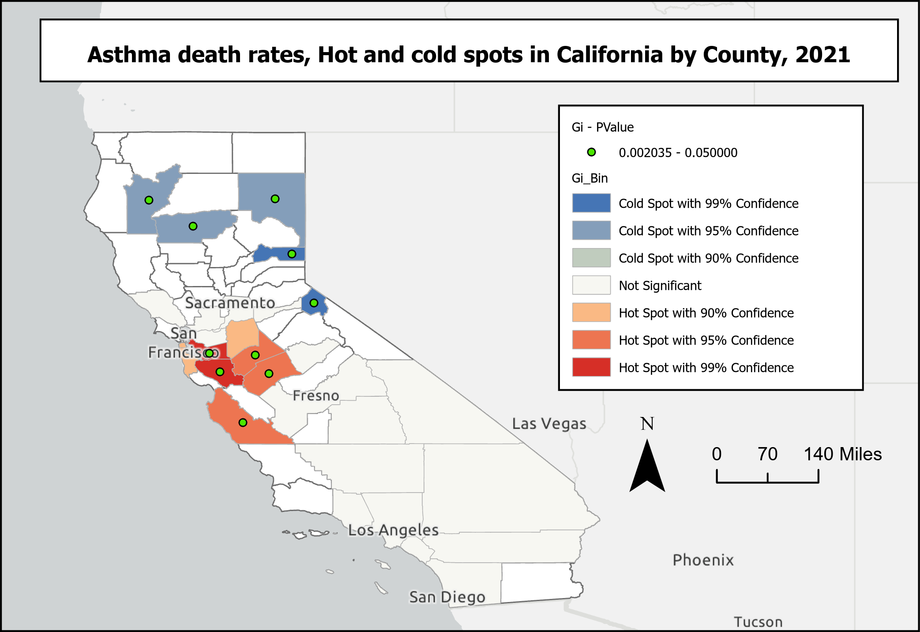
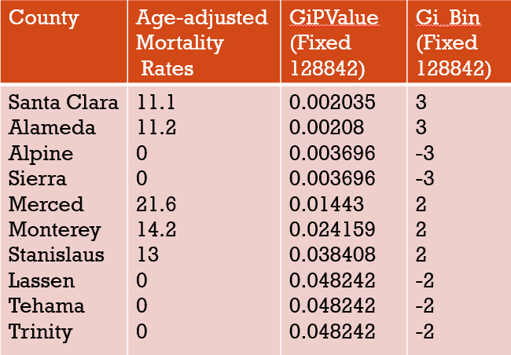
Results: Hot spot (Getis-Ord Gi)
Notes:
Mendocino County exhibits the highest mortality rate at 21.6 deaths per 1,000,000 residents , Hot spot 2 which is statistically significant with GiPValue=0.01443.

Slide 11
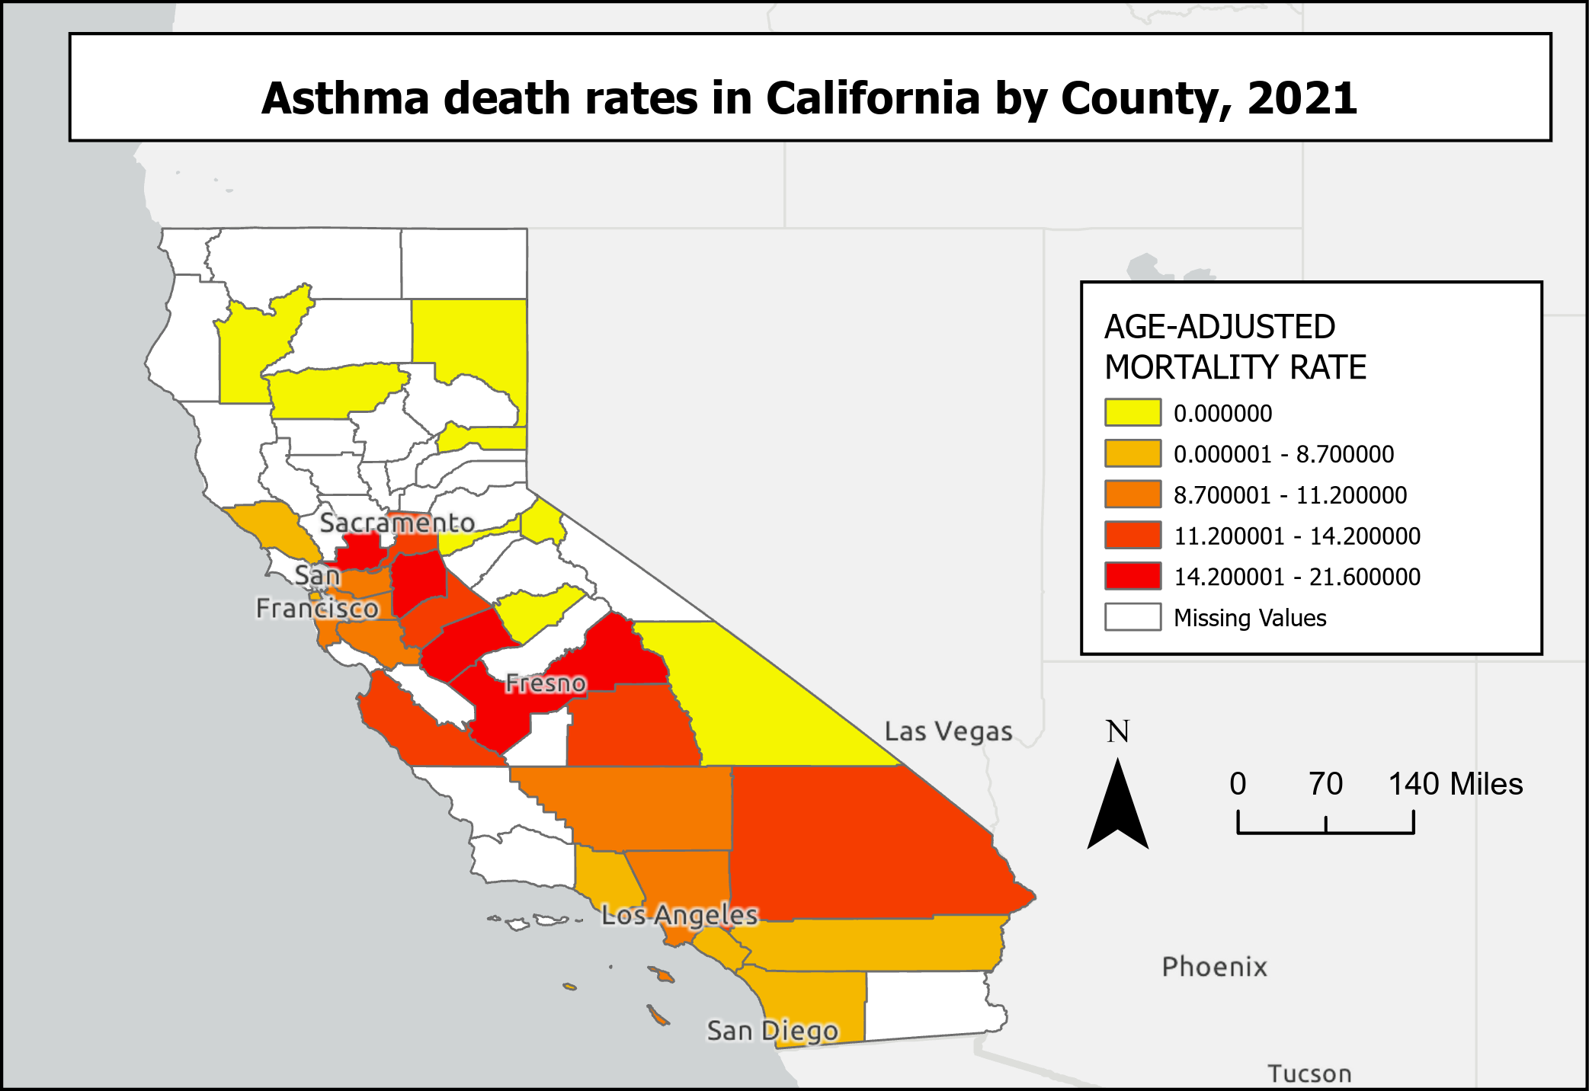
map

Slide 12
conclusion
Overall, in California, the age-adjusted mortality rate for asthma is 9.6 deaths per 1,000,000 residents.
Mendocino County exhibits the highest mortality rate at 21.6 deaths per 1,000,000 residents.
Identifying areas with the highest mortality rates, such as Mendocino County, is crucial for pinpointing regions with the greatest need for intervention.
By targeting interventions in high-risk areas, we can reduce disparities in healthcare access and outcomes and improve asthma management and care statewide.

Slide 13
References
Centers for Disease Control and Prevention. (2020). Asthma. https://www.cdc.gov/asthma/index.html
Global Initiative for Asthma. (2021). Global Strategy for Asthma Management and Prevention (2021 update). https://ginasthma.org/gina-reports/
California Department of Public Health. (2019). Asthma in California: A surveillance report. https://www.cdph.ca.gov/Programs/CCDPHP/DCDIC/CDCB/CDPH%20Document%20Library/AsthmaInCaliforniaSurveillanceReport2019.pdf
American Lung Association. (2020). Asthma disparities in America: A roadmap to reducing burdens on racial and ethnic minorities. https://www.lung.org/research/sota/diversity-asthma-disparities
California Department of Public Health. (n.d.). California Breathing: Asthma deaths among Californians statewide and by county . asthma-deaths-by-county Retrieved from https://www.cdph.ca.gov/Programs/CCDPHP/DEODC/EHIB/CPE/Pages/CaliforniaBreathing.aspx

Slide 14
Table
County | Age-adjusted Mortality Rates | GiPValue (Fixed 128842) | Gi_Bin (Fixed 128842)
Santa Clara Alameda Alpine Sierra Merced Monterey Stanislaus Lassen Tehama Trinity | 11.1 11.2 0 0 21.6 14.2 13 0 0 0 | 0.002035 0.00208 0.003696 0.003696 0.01443 0.024159 0.038408 0.048242 0.048242 0.048242 | 3 3 -3 -3 2 2 2 -2 -2 -2

Slide 15

Questions?

Slide 16


Thank you!

